Slide 1
COMP 2000
Week 14 - Wednesday

Slide 2
Last time
What did we talk about last time?
Review up to Exam 1
Java basics
Enhanced for loops
Enums
Packages
Interfaces
Inheritance
Exceptions

Slide 3
Questions?

Slide 4
Project 4

Slide 5
Final exam
Final exam will be held virtually:
Monday, April 27, 2020
10:15 a.m. to 12:15 p.m.
There will be multiple choice, short answer, and programming questions
I recommend that you use an editor like Notepad++ to write your answers, since Blackboard doesn't play nice with tabs
I don't recommend that you use Eclipse, since the syntax highlighting features will make you doubt yourself and try to get things perfect when getting them done is more important

Slide 6
Review up to Exam 2

Slide 7
JOptionPane

Slide 8
JOptionPane
JOptionPane class provides static methods for:
Displaying a message
Asking a question
Although it is possible to create a JOptionPane object, you almost never do
Just call the static methods
Which means typing a lot of JOptionPane.

Slide 9
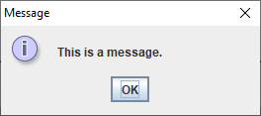
showMessageDialog() example
To display "This is a message." you could call the following:
JOptionPane.showMessageDialog(null,
"This is a message.");

Slide 10
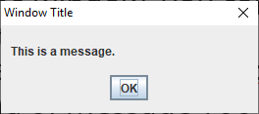
Adding a title
Most JOptionPane methods have many overloads
If you want to put a title on the window, you can pass it in as the third parameter
But this overloaded method also requires an int parameter that says what kind of message you want
To add the title "Window Title", you might call the following method:
JOptionPane.showMessageDialog(null,
"This is a message.", "Window Title",
JOptionPane.PLAIN_MESSAGE);

Slide 11
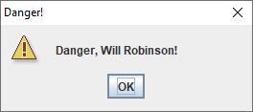
Different icons
You can choose an icon associated with one of the following constants:
ERROR_MESSAGE
INFORMATION_MESSAGE
WARNING_MESSAGE
QUESTION_MESSAGE
PLAIN_MESSAGE
JOptionPane.showMessageDialog(null,
"Danger, Will Robinson!", "Danger!",
JOptionPane.WARNING_MESSAGE);

Slide 12
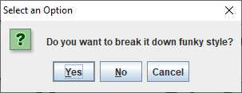
showConfirmDialog() example
int answer = JOptionPane.showConfirmDialog(null,
"Do you want to break it down funky style?");
if(answer == JOptionPane.YES_OPTION)
JOptionPane.showMessageDialog(null, "Dope!");
else
JOptionPane.showMessageDialog(null, "Weak!");
Hitting the X in the corner is the same as Cancel

Slide 13
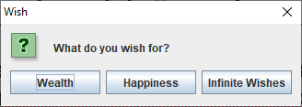
showOptionDialog() example
Here's an example showing a dialog that allows a user to choose between Wealth, Happiness, and Infinite Wishes
Note that many parameters can be null: parent, icon, default option
String[] options = {"Wealth", "Happiness", "Infinite Wishes"};
int answer = JOptionPane.showOptionDialog(null,
"What do you wish for?", "Wish", JOptionPane.DEFAULT_OPTION,
JOptionPane.QUESTION_MESSAGE, null, options, null);

Slide 14
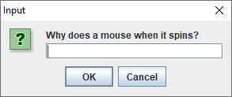
showInputDialog() example
This input dialog asks a pressing question
As with other methods, there are overloaded versions that allow for titles, icons, and other options
String answer = JOptionPane.showInputDialog(null,
"Why does a mouse when it spins?");

Slide 15
JFrame

Slide 16
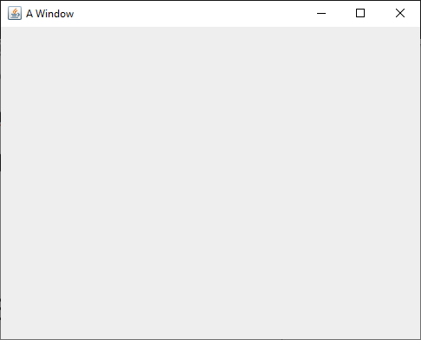
Creating a JFrame
To create a JFrame, we will usually call its constructor that takes a String, giving it a title
Then, we have to make it visible so that we can see it
JFrame frame = new JFrame("A Window");
frame.setVisible(true);

Slide 17
setDefaultCloseOperation()
Next, you'll notice that closing the window doesn't end the program
The little red square on the Eclipse Console is still clickable, meaning that the program is running
By default, closing the window by clicking its X only hides the window
By calling the setDefaultCloseOperation(), we can make it so that the default operations is dispose (getting rid of the window)
Many books suggest passing in JFrame.EXIT_ON_CLOSE, but you should not!
Doing so will kill the rest of your program like System.exit()
JFrame frame = new JFrame("A Window");
frame.setSize(500, 400);
frame.setDefaultCloseOperation(JFrame.DISPOSE_ON_CLOSE);
frame.setVisible(true);

Slide 18
Recap
To use a JFrame you must:
Create a JFrame object
Set its size (either directly or by putting widgets on it and then calling pack())
Set its default close operation to dispose
Make it visible
Now that we've got a window, we can put widgets on it!

Slide 19
Widgets
Widget is a generic term for a wide range of GUI controls
Buttons
Labels (allowing us to put text or images on a GUI)
Text fields
Text areas (like text fields but larger)
Menus
Checkboxes
Radio buttons
Lists
Combo boxes
Sliders

Slide 20
JButton
A button you can click on is provided by the JButton class
A JButton is usually created with text or an image
You'll need to make JButtons with images for Project 2
Just creating the JButton doesn't do anything
You have to add it to a JFrame (or other container) to see it
Right now, we're just creating the buttons
Next week, we'll learn how to add actions to them
JButton button = new JButton("Push me!");

Slide 21
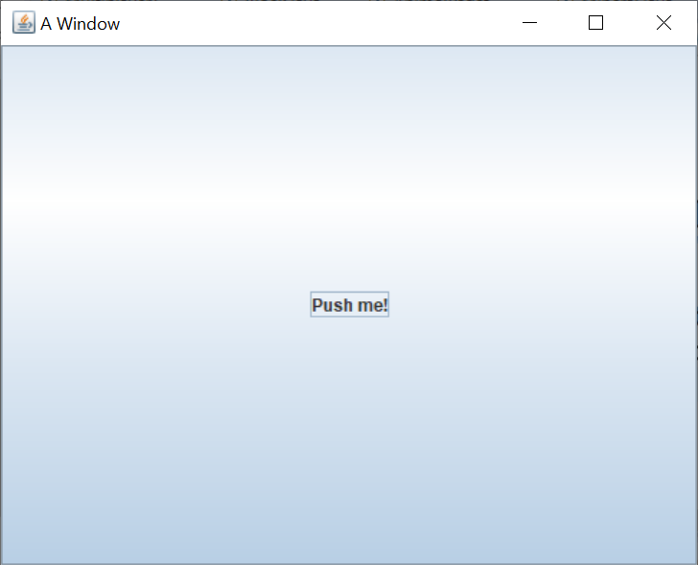
Adding a JButton to a JFrame
Once you've created a JButton, you can add it to a JFrame by calling the add() method on the JFrame
All GUI containers have an add() method that allows us to add a widget to it
JFrame frame = new JFrame("A Window");
frame.setSize(500, 400);
frame.setDefaultCloseOperation(JFrame.DISPOSE_ON_CLOSE);
JButton button = new JButton("Push me!");
frame.add(button);
frame.setVisible(true);

Slide 22
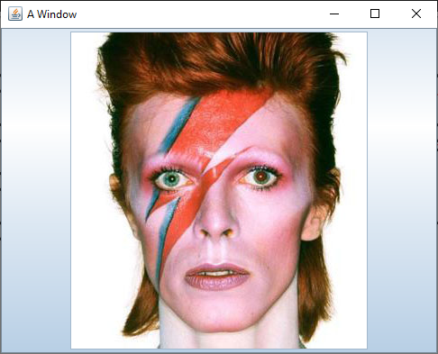
Displaying an icon on a JButton
You can also make a JButton with an image instead of text
To do so, you create an ImageIcon and pass that to the constructor of the JButton
You'll need the path to an image
JButton bowieButton = new JButton(new ImageIcon("bowie.jpg"));
frame.add(bowieButton, BorderLayout.CENTER);

Slide 23
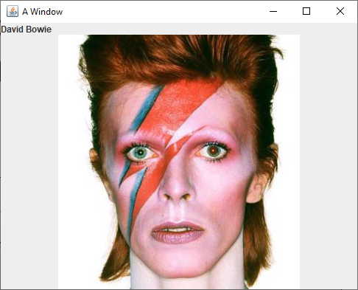
JLabel
A JLabel is like a button you can't click
Its constructors work just like the JButton ones
It allows you to display text or an image
JLabel nameLabel = new JLabel("David Bowie");
JLabel bowieLabel = new JLabel(new ImageIcon("bowie.jpg"));
frame.add(nameLabel, BorderLayout.NORTH);
frame.add(bowieLabel, BorderLayout.CENTER);

Slide 24
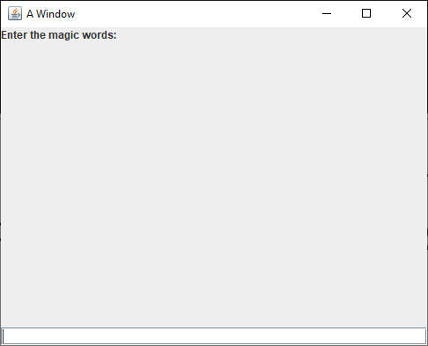
JTextField
A JTextField allows a user to enter a (short) amount of text
Usually, you'll need a JLabel to tell the person what they should enter
The example is ugly because the JLabel and the JTextField don't fill the 500 x 400 JFrame
JLabel messageLabel = new JLabel("Enter the magic words:");
JTextField magicField = new JTextField();
frame.add(messageLabel, BorderLayout.NORTH);
frame.add(magicField, BorderLayout.SOUTH);

Slide 25
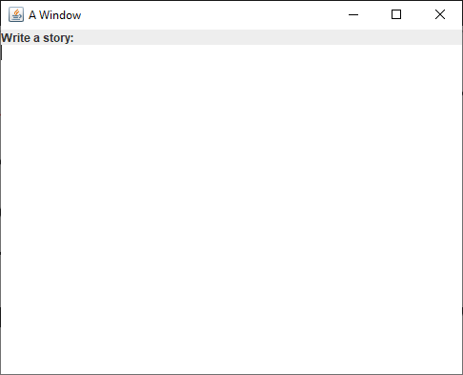
JTextArea
A JTextField is for entering small pieces of information
Name
Address
Telephone number
For larger texts, we can use a JTextArea
JLabel storyLabel = new JLabel("Write a story:");
JTextArea storyArea = new JTextArea();
frame.add(storyLabel, BorderLayout.NORTH);
frame.add(storyArea, BorderLayout.CENTER);

Slide 26
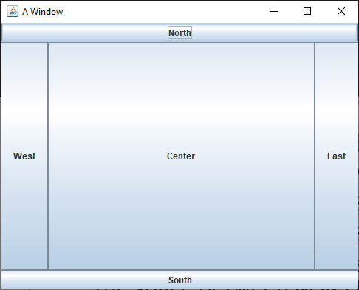
BorderLayout
BorderLayout is the default layout for JFrame
When you add widgets, you can specify the location as one of five regions:
BorderLayout.NORTH stretches the width of the container on the top
BorderLayout.SOUTH stretches the width of the container on the bottom
BorderLayout.EAST sits on the right of the container, stretching to fill all the space between NORTH and SOUTH
BorderLayout.WEST sits on the left of the container, stretching to fill all the space between NORTH and SOUTH
BorderLayout.CENTER sits in the middle of the container and stretches to fill all available space
If you don't specify where you're adding a widget, it adds to CENTER
If you add more than one widget to a region, the new one replaces the old
Unused regions disappear

Slide 27
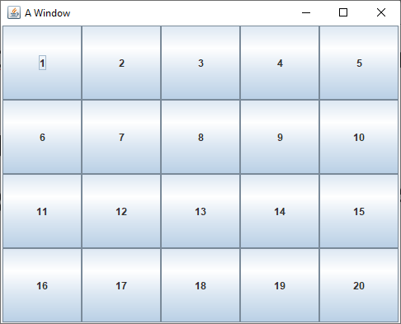
GridLayout
GridLayout allows you to create a grid with a specific number of rows and columns
All the cells in the grid are the same size
As you add widgets, they fill each row
frame.setLayout(new GridLayout(4, 5));
for(int row = 0; row < 4; ++row)
for(int column = 0; column < 5; ++column)
frame.add(new JButton("" + (row * 5 + column + 1)));

Slide 28
Action Listeners

Slide 29
Making buttons do things
We have added JButtons to JFrames, but those buttons don't do anything
When clicked, a JButton fires an event
We need to add an action listener to do something when that event happens
A CLI program runs through loops, calls methods, and makes decisions until it runs out of stuff to do
GUIs usually have this event-based programming model
They sit there, waiting for events to cause methods to get called

Slide 30
ActionListener interface
What can listen for a JButton to click?
Any object that implements ActionListener
ActionListener is an interface like any other with a single abstract method in it:
void actionPerformed(ActionEvent e);
We need to write a class with such a method
We will rarely need to worry about the ActionEvent object
But it does have a getSource() method that will give us the Object (often a JButton) that fired the event

Slide 31
Anonymous inner classes
Now, we get to something tricky
It's possible to create a class on the fly, right in the middle of other code
Consider the following interface:
We can create, in the middle of other code, a class that implements NoiseMaker, like this:
public interface NoiseMaker {
String makeNoise();
}
NoiseMaker maker = new NoiseMaker() {
public String makeNoise() {
return "Yowza!";
}
};

Slide 32
Adding an action listener
The reason we brought up anonymous inner classes is that we can use this syntax to make an ActionListener object right when we need it, for a button
It's ugly, but it works
JButton button = new JButton("Push me!");
button.addActionListener(new ActionListener() {
public void actionPerformed(ActionEvent e) {
button.setText("Ouch!"); // arbitrary code
}
}); // ugly: parenthesis for end of method call

Slide 33
Java 8 style
Before Java 8, we only had two choices:
Make a whole class that implements ActionListener and might have to do different actions based on which button fired the event
Make a separate anonymous inner class for every single button, each doing the action for that button
Java 8 adds something called lambdas which actually make anonymous inner classes too, but the syntax is much nicer
Java 8 style:
JButton button = new JButton("Push me!");
button.addActionListener(e -> button.setText("Ouch!"));

Slide 34
More on Java 8 style
An interface with only a single method in it (like ActionListener) is called a functional interface
Java 8 lets us instantiate functional interface by filling out the method:
(Type1 arg1, Type2 arg2, …) -> { /* method body */ }
But if it's possible for the compiler to infer the argument types, they don't have to be written
If you only have a single argument, you don't need parentheses
And if you only have a single line in your method body, you don't need braces
Multi-line example:
JButton button = new JButton("Push me!");
button.addActionListener(e -> {
button.setText("Ouch!");
button.setEnabled(false);
});

Slide 35
Recursion
To understand recursion, you must first understand recursion.

Slide 36
What is recursion?
Defining something in terms of itself
To be useful, the definition must be based on progressively simpler definitions of the thing being defined

Slide 37
Useful Recursion
Two parts:
Base case(s)
Tells recursion when to stop
For factorial, n = 1 or n = 0 are examples of base cases
Recursive case(s)
Allows recursion to progress
"Leap of faith"
For factorial, n > 1 is the recursive case

Slide 38
Approach for Problems
Top down approach
Don't try to solve the whole problem
Deal with the next step in the problem
Then make the "leap of faith"
Assume that you can solve any smaller part of the problem

Slide 39
Code for Factorial
public static long factorial( int n )
{
if( n <= 1 )
return 1;
else
return n*factorial( n – 1 );
}
Base Case
Recursive
Case

Slide 40
Recursive style
When we do recursion, we want to pass all the data in through our method arguments
We want to get all of our results back through return statements
Think of each recursive method call as a frozen moment in time
Thus, we usually don't want to assign variables
Instead, variables change as they pass to the next method call

Slide 41
Call stack
Local variables for each method are stored on the stack
When a method is called, a copy of that method is pushed onto the stack
When a method returns, that copy of the method pops off the stack
Call
Return
Call
factorial
solve
solve
solve
main
main
main
main

Slide 42
Example with Factorial
Each copy of factorial has a value of n stored as a local variable
For 6! :
1
factorial(1)
1
2*factorial(1)
factorial(2)
2
3*factorial(2)
factorial(3)
6
4*factorial(3)
factorial(4)
24
5*factorial(4)
factorial(5)
120
6*factorial(5)
factorial(6)
720
x = factorial(6);

Slide 43
Exponentiation
Similarly, exponentiation is repeated multiplication
Thus, $x^{y}=x∙x∙x…∙x$
($y$ times)
Base case (y = 0):
$x^{0}=1$
Recursive case (y > 0):
$x^{y}=x∙x^{y−1}$
There is a more efficient way to do this, but you'll have to take COMP 2100 to talk about it

Slide 44
Code for exponentiation
public static double power( double x, int y ){
if( y == 0 )
return 1.0;
else
return x * power( x, y - 1 );
}
Base Case
Recursive
Case

Slide 45
Extra information
Recursion sometimes requires similar information that can be passed along to each recursive call
This information could be an index into a String or an array
In graph or tree algorithms, it might be the parent node you visited previously
There are recursive methods with 10 or more parameters
There's nothing wrong with that, provided that you actually need them all

Slide 46
Summing an array
What if we want to sum the values in an array called array?
We need some extra information: current index
Base case (index = length):
Sum(from index onward):
0 (Nothing left to sum)
Recursive case (index < length):
Sum(from index onward):
array[index] + Sum(from index + 1 onward)

Slide 47
Code for summing an array
public static double sum(double array[], int index) {
if( index == array.length )
return 0.0;
else
return array[index] + sum(array, index + 1);
}
Base Case
Recursive
Case

Slide 48
Reversing a String
What if we want to reverse the contents of a string called s?
We need some extra information: current index
Base case (index = length):
Reverse(from index onward):
"" (Nothing left to reverse)
Recursive case (index < length):
Reverse(from index onward):
s[length – index - 1] + Reverse(from index + 1 onward)

Slide 49
Code for reversing a String
public static String reverse(String s, int index) {
if( index == s.length() )
return "";
else
return s.charAt(s.length() – index – 1) + reverse(s, index + 1);
}
Base Case
Recursive
Case

Slide 50
Using the stack to go in reverse
All stacks (including the call stack) are first-in last-out (FILO) structures
In situations where we want to deal with things in backwards order, we can use this natural reversing tendency
For example, if we want to print out a String in reverse, we can recurse through each character and print them as the recursion returns
Doesn't make sense yet?

Slide 51
Printing a String in reverse
What if we want to print the contents of a string called s in reverse?
We need some extra information: current index
Base case (index = length):
ReversePrint(from index onward):
Print nothing
Recursive case (index < length):
ReversePrint(from index onward):
ReversePrint(from index + 1 onward)
Then print s [index]

Slide 52
Code for printing a String in reverse
public static void reversePrint(String s, int index)
{
if( index < s.length() ) {
reversePrint(s, index + 1); System.out.print(s.charAt(index));
}
}
(Empty) Base Case
Recursive
Case

Slide 53
Reversing a String (the remix)
We can even use this approach to reverse a string in a different manner than we did before
Base case (index = length):
Backwards(from index onward):
"" (Nothing left to reverse)
Recursive case (index < length):
Backwards(from index onward):
Backwards(from index + 1 onward) + s[index]

Slide 54
Remixed code for reversing a String
public static String backwards(String s, int index) {
if( index == s.length() )
return "";
else
return backwards(s, index + 1) + s.charAt(index);
}
Base Case
Recursive
Case

Slide 55
Merge Sort

Slide 56
Merge Sort algorithm (recursive)
Beautiful divide and conquer algorithm
Base case: List has size 1
You're done!
Recursive case: List has size greater than 1
Divide your list in half
Recursively merge sort each half
Merge the two halves back together in sorted order

Slide 57
Merge Sort code
public static void mergeSort(int [] array) {
if(array.length > 1) {
int[] a = new int[array.length/2];
int[] b = new int[array.length – a.length];
for(int i = 0; i < a.length; ++i) //copy first half
a[i] = array[i];
for(int i = 0; i < b.length; ++i) //copy second half
b[i] = array[i + a.length];
mergeSort(a); //sort first half
mergeSort(b); //sort second half
merge(a, b, array);
}
}
(Empty)
Base Case
Recursive
Case

Slide 58
Merging (the hard part)
The code to merge two sorted subarrays into a third array trips up a lot of people
Use three indexes, one for each array
Always copy the smaller value from the two subarrays
The tricky part is that you might no longer have anything left to copy from a subarray
At that point, you must copy from the other subarray
In other words, always check the validity of an index before using it

Slide 59
Merge code
public static void merge(int[] a, int[] b, int[] array) {
int aIndex = 0;
int bIndex = 0;
for(int i = 0; i < array.length; ++i) {
if(aIndex >= a.length)
array[i] = b[bIndex++];
else if(bIndex >= b.length)
array[i] = a[aIndex++];
else if(a[aIndex] <= b[bIndex])
array[i] = a[aIndex++];
else
array[i] = b[bIndex++];
}
}

Slide 60
Merging
I prefer the merging given on the previous slide
A single for loop that fills the array makes sense to me
I'm not a huge fan of using the postincrement operator (aIndex++), but this is what it's designed for:
Getting a value and then incrementing it, all in a single line of code
Otherwise, we'd need braces for the cases
Note that you can combine the four seemingly repetitive cases into three cases (but not two)
Another way to do the merge is with three while loops, given on the next slide

Slide 61
Merge code (alternative)
public static void merge(int[] a, int[] b, int[] array) {
int aIndex = 0;
int bIndex = 0;
int i = 0;
while(aIndex < a.length && bIndex < b.length) {
if(a[aIndex] <= b[bIndex])
array[i] = a[aIndex++];
else
array[i] = b[bIndex++];
++i;
}
while(aIndex < a.length) {
array[i] = a[aIndex++];
++i;
}
while(bIndex < b.length) {
array[i] = b[bIndex++];
++i;
}
}

Slide 62
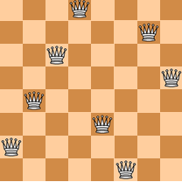
N-Queens
Given an N x N chess board, where N ≥ 4 it is possible to place N queens on the board so that none of them are able to attack each other in a given move
Write a method that, given a value of N, will return the total number of ways that the N queens can be placed

Slide 63
Problem solving approach
We will use recursion to place queens on the board, one row at a time
To save typing, we will use a loop to place the queen at each different column within the row and then recurse
Egad! A loop inside recursion!
It happens.
If we have placed queens on all the rows, we return 1 (a successful placement)
We sum up all the successful placements that our recursive children make

Slide 64
N-Queens algorithm (recursive)
Base case: (row = 8)
You have placed queens on rows 0-7
Return 1 (a successful placement)
Recursive case: (row < 8)
Keep a sum of the successful placements made by placing in future rows, initially 0
Try to place a queen on columns 0-7
For each successful column placement, recursively try to place queens on the next row and add those successful placements to your sum
Return sum

Slide 65
Files

Slide 66
Text files
First, we're going to talk about text files
All files are sequences of bytes stored in binary, but in text files, those bytes form human-readable text like words and numbers
Unlike files storing data in binary, working with text files is similar to the command-line I/O we've been doing since before COMP 2000
Examples of text files:
Source code for most programming languages (.c, .java, .py files, etc.)
Plain text files (often with a .txt extension)
Many configuration and log files

Slide 67
Reading
Reading from a text file is straightforward
We use Scanner, just like reading from the command line
We just have to create a new File object that gives the file path we want to read from
This code will read from some file called input.txt, as if someone were typing its contents into the command line
Scanner in = new Scanner(new File("input.txt"));

Slide 68
Scanner methods
Recall that we can read correctly formatted text with a Scanner using the following methods
nextInt() Reads an int value
nextDouble() Reads a double value
next() Reads a white-space delimited String
nextLine() Reads a String up to the next newline (which can cause problems if there's a newline left over from previous reads)
These methods are usually what you need to get the job done, but there are also nextBoolean(), nextByte(), nextFloat(), nextLong(), and nextShort() methods
Note that all the integer reading methods have a second version that takes a base so that you can read values in bases 2-36

Slide 69
Writing
Writing to files uses a different sequence of steps
If you want to write to a text file, you've got to create a PrintWriter object, based on a FileOutputStream object (which takes the file name as a parameter)
Once you've got a PrintWriter, you can use it just like System.out
PrintWriter out = new PrintWriter(new FileOutputStream ("output.txt"));

Slide 70
Exceptions
When making a Scanner from a File or making a PrintWriter from a FileOutputStream can potentially throw a FileNotFoundException
Since it's a checked exception, you need a try-catch or a throws

Slide 71
Writing example
This example opens a file called goodbye.txt, writes some text, and then closes the file
Note that we are not showing the try-catch or throws
PrintWriter out = new PrintWriter(new FileOutputStream ("goodbye.txt"));
out.println("So long!");
out.println("Farewell!");
out.println("Auf Wiedersehen!");
out.println("Goodbye!");
out.close();

Slide 72
Shut 'em down!
You should always close files as soon as you're done reading from them or writing to them
If you don't close files you're writing to before your program ends, output can be lost
Keeping files open ties up system resources
There's a maximum number of files one program can have open at a time
Since we always want to close files, it's smart to put the closing in a finally block

Slide 73
Full example
This example copies the text from input.txt to output.txt
Scanner in = null;
PrintWriter out = null;
try {
in = new Scanner(new File("input.txt"));
out = new PrintWriter(new FileOutputStream ("output.txt"));
while(in.hasNextLine())
out.println(in.nextLine());
}
catch(FileNotFoundException e) {
e.printStackTrace();
}
finally {
if(in != null) in.close();
if(out != null) out.close();
}

Slide 74
Why use binary files?
Wouldn't it be easier to use all human readable files?
Binary files can be more efficient
In binary, all int values are 4 bytes
In text, they can take up a lot more
In text, you also need a space or other separator to divide the numbers
Integer | Bytes in text representation
0 | 1
92 | 2
789 | 3
4551 | 4
10890999 | 8
204471262 | 9
-2000000000 | 11

Slide 75
Most files are binary files
Because they have a representation that is more compact (and more similar to how data is stored in your program), most files are binary (non-human-readable) files
Many media files start with metadata
Format information
Size
Then, they have the actual data (RGB values, audio samples, frames of video, etc.)
Binary files include most common file formats: .jpg, .png, .mp3, .avi, .pdf, .docx, .pptx, and on and on

Slide 76
Reading binary files
Reading from binary files uses a completely different set of objects than reading from text files
We create a DataInputStream from a FileInputStream
The FileInputStream takes the name of the file path
You can create a FileInputStream first on a separate line, but there's no need to do so
DataInputStream in = new DataInputStream(new FileInputStream("input.dat"));

Slide 77
Example summing double values
The following code assumes that a file contains starts with an int value giving the number of double values that come after it
DataInputStream in = null;
try {
in = new DataInputStream(new FileInputStream("numbers.dat"));
int length = in.readInt();
double sum = 0.0;
for(int i = 0; i < length; ++i)
sum += in.readDouble();
System.out.println("Sum: " + sum);
}
catch(IOException e) {
System.out.println("File problems!");
}
finally {
try{ in.close(); } catch(Exception e){}
}

Slide 78
Error handling
The reading methods in DataInputStream can throw:
EOFException if the end of the file was reached but you still try to read something
IOException if the stream was closed (or something else goes wrong)
Since EOFException and even FileNotFoundException are both children of IOException, it's possible (as we did on the previous slide) to have a single catch block that handles an IOException

Slide 79
Closing the file
As with text files, we closed our files in a finally block
You might have noticed that there was a baby try-catch block inside of there as well
For whatever reason, closing a DataInputStream can throw an IOException
By having a try-catch that will catch anything, we deal with the IOException as well as catching the NullPointerException that happens if we try to close a null DataInputStream
Is that a good idea?
Eh…it's fine: We're just trying to close the file and not crash our program
finally {
try{ in.close(); } catch(Exception e){}
}

Slide 80
Writing binary files
Writing to binary files is very similar to reading from binary files
We create a DataOutputStream from a FileOutputStream
The FileOutputStream takes the name of the file path
The writing methods are similar too
DataOutputStream out = new DataOutputStream(new FileOutputStream("output.dat"));

Slide 81
Example writing double values
The following code assumes that a file starts with an int value giving the number of double values that come after it
DataOutputStream out = null;
try {
out = new DataOutputStream(new FileOutputStream("numbers.dat"));
out.writeInt(100);
for(int i = 0; i < 100; ++i)
out.writeDouble(Math.random() * 1000);
}
catch(IOException e) {
System.out.println("File problems!");
}
finally {
try{ out.close(); } catch(Exception e){}
}

Slide 82
Putting the I/O together
File input and output need to match each other well, especially for binary I/O
If data values are out of order, you'll get garbage, and it'll be hard to know why
Once you write the file output code, you can easily copy and paste it to write the input code
Change every out to in
Change every write to read (and move the method arguments to save return values)
The structures are parallel

Slide 83
Serialization
Serialization takes a reference to an object and dumps it into a file
It writes representations to primitive types pretty much the same way that a DataOutputStream does
And if there're objects inside of the object you're serializing, it serializes them too
And! Serialization makes a note of all the objects that are getting serialized, so if it sees an object a second time, it just writes down a serial number for it instead of the whole thing

Slide 84
Serializable interface
Serialization is one of the closest things to magic you'll see in programming
You only need to implement the Serializable interface on your object
And the Serializable interface has no methods!
It's just a way of marking an object as reasonable to try to dump into a file
Most objects are reasonable to dump into a file!

Slide 85
Example Serializable class
Here's a class we might want to be able to dump into a file
public class Troll implements Serializable {
private String name;
private int age;
private Object hatedThing; // All trolls hate something
public Troll(String name, int age, Object hatedThing) {
this.name = name;
this.age = age;
this.hatedThing = hatedThing;
}
public Object getHatedThing() {
return hatedThing;
}
}

Slide 86
Writing using serialization
To write an object marked Serializable, you need to create an ObjectOutputStream
You create an ObjectOutputStream the same way that you create a DataOutputStream, by passing in a FileOutputStream
At this point, you might be wondering why all these objects take FileOutputStream objects and can't take just take a File object or even a file name
In actuality, you can pass in any OutputStream object (of which FileOutputStream is a child), like maybe one that sends the data across the network instead of storing it into a file
An ObjectOutputStream object has many methods, but the only one that matters is writeObject()
Pass your object to that method and it'll get written out in its totality, no fuss

Slide 87
Example of writing
Here's some code that creates a couple of Troll objects and then writes them to a file called trolls.dat
Troll tom = new Troll("Tom", 351, "Bilbo Baggins");
Troll bert = new Troll("Bert", 417, tom);
ObjectOutputStream out = null;
try {
out = new ObjectOutputStream(new FileOutputStream("trolls.dat"));
out.writeObject(tom);
out.writeObject(bert);
}
catch(IOException e) {
System.out.println("Serialization failed.");
}
finally { try{ out.close(); } catch(Exception e){} }

Slide 88
Reading using serialization
To read objects that have been serialized to a file, you need to create an ObjectInputStream
You create an ObjectOutputStream the same way that you create a DataInputStream, by passing in a FileInputStream
For each object serialized, you call the readObject() method to restore it from the file
Note that readObject() has a return type of Object, so you'll need to cast your object if you want to store it in a reference of its own type

Slide 89
Example of reading
Here's some code that reads in the Troll objects we serialized in the previous example
Troll tom = null;
Troll bert = null;
ObjectInputStream in = null;
try {
in = new ObjectInputStream(new FileInputStream("trolls.dat"));
tom = (Troll)in.readObject();
bert = (Troll)in.readObject();
}
catch(IOException e) {
System.out.println("Deserialization failed.");
}
finally { try{ in.close(); } catch(Exception e){} }

Slide 90
Networking

Slide 91
What is the Internet?
The network of hardware and software systems that connects many of the world's computers
Typically, people say the Internet and capitalize the "I" because there is only one
Until we meet aliens
Or decide to break off from the rest of the world
The World Wide Web is the part of the Internet that is concerned with webpages
The Internet also includes:
FTP
VOIP
Bittorrent
Multiplayer video games
Much, much more…

Slide 92
Packet switched
The Internet is a packet switched system
Individual pieces of data (called packets) are sent on the network
Each packet knows where it is going
A collection of packets going from point A to point B might not all travel the same route
C
1
B
A
2
D

Slide 93
IP addresses
Computers on the Internet have addresses, not names
Google.com is actually [74.125.67.100]
Google.com is called a domain
The Domain Name System or DNS turns the name into an address

Slide 94
IPv4
Old-style IP addresses are in this form:
74.125.67.100
4 numbers between 0 and 255, separated by dots
That's a total of 256⁴ = 4,294,967,296 addresses
But there are 7 billion people on earth…

Slide 95
IPv6
IPv6 are the new IP addresses that are beginning to be used by modern hardware
8 groups of 4 hexadecimal digits each
2001:0db8:85a3:0000:0000:8a2e:0370:7334
1 hexadecimal digit has 16 possibilities
How many different addresses is this?
16³² = 2¹²⁸ ≈ 3.4×10³⁸ is enough to have 500 trillion addresses for every cell of every person's body on Earth
Will it be enough?!

Slide 96
OSI 7 layer model
Not every layer is always used
Sometimes user errors are referred to as Layer 8 problems
Layer | Name | Mnemonic | Activity | Example
7 | Application | Away | User-level data | HTTP
6 | Presentation | Pretzels | Data appearance, some encryption | Unicode
5 | Session | Salty | Sessions, sequencing, recovery | TLS
4 | Transport | Throw | Flow control, end-to-end error detection | TCP
3 | Network | Not | Routing, blocking into packets | IP
2 | Data Link | Dare | Data delivery, packets into frames, transmission error recovery | Ethernet
1 | Physical | Programmers | Physical communication, bit transmission | Electrons in copper

Slide 97
Physical layer
There is where the rubber meets the road
The actual protocols for exchanging bits as electronic signals happen at the physical layer
At this level are things like RJ45 jacks and rules for interpreting voltages sent over copper
Or light pulses over fiber

Slide 98
Data link layer
Ethernet is the most widely used example of the data layer
Machines at this layer are identified by a 48-bit Media Access Control (MAC) address
The Address Resolution Protocol (ARP) can be used for one machine to ask another for its MAC address
Some routers allow a MAC address to be spoofed, but MAC addresses are intended to be unique and unchanging for a particular piece of hardware

Slide 99
Network layer
The most common network layer protocol is Internet Protocol (IP)
Each computer connected to the Internet should have a unique IP address
IPv4 is 32 bits written as four numbers from 0 – 255, separated by dots
IPv6 is 128 bits written as 8 groups of 4 hexadecimal digits
We can use tracert on Windows to see the path of hosts leading to some IP address

Slide 100
Transport layer
There are two popular possibilities for the transport layer
Transmission Control Protocol (TCP) provides reliability
Sequence numbers for out of order packets
Retransmission for packets that never arrive
User Datagram Protocol (UDP) is simpler
Packets can arrive out of order or never show up
Many online games use UDP because speed is more important

Slide 101
Session layer
This layer doesn't necessarily exist in the TCP/IP model
Transport Layer Security (TLS) uses the session layer
TLS is the end-to-end encryption that HTTPS uses
You know you're using TLS if there's a little lock showing on your browser
Google is pushing for all websites to be HTTPS
HTTPS is safer, but there's some overhead for the encryption, and websites have to have certificates for their public keys

Slide 102
Presentation layer
The presentation layer is often optional
It specifies how the data should appear
This layer is responsible for character encoding (ASCII, UTF-8, etc.)
MIME types are sometimes considered presentation layer issues

Slide 103
Application layer
This is where the data is interpreted and used
HTTP is an example of an application layer protocol
A web browser takes the information delivered via HTTP and renders it
Code you write deals significantly with the application layer

Slide 104
Mnemonics
Seven layers is a lot to remember
Mnemonics have been developed to help
Application | All | All | A | Away
Presentation | Pros | People | Powered-Down | Pretzels
Session | Search | Seem | System | Salty
Transport | Top | To | Transmits | Throw
Network | Notch | Need | No | Not
Data Link | Donut | Data | Data | Dare
Physical | Places | Processing | Packets | Programmers

Slide 105
TCP/IP
The OSI model is sort of a sham
It was invented after the Internet was already in use
You don't need all layers
Some people think this categorization is not useful
Most network communication uses TCP/IP
We can view TCP/IP as four layers:
Layer | Action | Responsibilities | Protocol
Application | Prepare messages | User interaction | HTTP, FTP, etc.
Transport | Convert messages to packets | Sequencing, reliability, error correction | TCP or UDP
Internet | Convert packets to datagrams | Flow control, routing | IP
Physical | Transmit datagrams as bits | Data communication

Slide 106
TCP/IP
A TCP/IP connection between two hosts (computers) is defined by four things
Source IP
Source port
Destination IP
Destination port
One machine can be connected to many other machines, but the port numbers keep the different connections straight

Slide 107
Common port numbers
Certain kinds of network communication are usually done on specific ports
20 and 21: File Transfer Protocol (FTP)
22: Secure Shell (SSH)
23: Telnet
25: Simple Mail Transfer Protocol (SMTP)
53: Domain Name System (DNS) service
80: Hypertext Transfer Protocol (HTTP)
110: Post Office Protocol (POP3)
443: HTTP Secure (HTTPS)

Slide 108
Clients vs. servers
Using sockets is usually associated with a client-server model
A server is a process that sits around waiting for a connection
When it gets one, it can do sends and receives
A client is a process that connects to a waiting server
Then it can do sends and receives
Clients and servers are processes, not computers
You can have many client and server processes on a single machine

Slide 109
Listening server
The server sits there, waiting for a client to connect
Until that happens, the accept() method will not return
When it does return, it will return with a socket that can be used for communicating with the client
Server
Client
Requesting connection…

Slide 110
Loopback IP address
It's inconvenient to need two different computers to write network code
For testing purposes, you can often use a single computer as both the server and the client
To do so, you need to connect to yourself
What's your IP address?
Well, it might always be changing
To make things simpler, there's a loopback IP address that always refers to the computer you're currently on: 127.0.0.1
The IPv6 loopback address is ::1 (where :: is notation that means "fill in with appropriate numbers of zeroes")

Slide 111
Practice questions
Write a program that prompts a user for a number with a JOptionPane method and uses another JOptionPane method to show whether or not the number is prime
Create a JFrame containing an 8 × 8 grid of JButton objects
For those buttons that would be black in a chess board, use the setBackground() method to make them black
For the rest, use the setBackground() method to make them white
Write a recursive method that sums up every other element in an array (in other words, only those with even indexes)
Write a networked client program that
Connects to a specified port and IP address
Creates a Scanner to read from the socket
Tries to read whitespace-delimited words from the Scanner until it reads the String "###stop###"
Prints out the String it sees that comes first in lexicographic ordering (which is determined using compareTo())

Slide 112
Quiz

Slide 113
Upcoming

Slide 114
Next time…
Review everything after Exam 2
Dynamic data structures (including linked lists)
Generics
Java Collection Framework
List
ArrayList
LinkedList
Map
HashMap
TreeMap
Set
HashSet
TreeSet
Sorting tools
Design
Testing

Slide 115
Reminders
Finish Project 4
Due Friday
Review chapters 16 and 18 and notes
Look over labs, quizzes, and projects to prepare
Final Exam:
Monday, April 27, 2020
10:15 a.m. to 12:15 p.m.

